Slide 1
Real-Time Operating Systems
Concepts, Scheduling, Multitasking, Synchronisation and Queues

Slide 2

Real-Time Operating System
An operating system that is able to respond and process events within a predefined time limit (time critical embedded systems)
Supports parallelism (multithreading/multitasking)
Useful in modern embedded applications, e.g. IoT in combination with AI
Powerful tool but requires a good design to avoid unexpected problems and complexity
When designed well, improves modularity, clean interfaces and easier testing

Slide 3





Popular RTOS’es
The Linux Foundation
Amazon
Segger
And many others…
VXWorks by WindRiver
Mbed OS by ARM

Slide 4

freeRTOS
Market leader in free RTOS software especially useful for small embedded systems
Currently owned by Amazon
Growing IoT functionality
Easy to use
Available ports for ESP32
Next slides talk mostly about freeRTOS

Slide 5
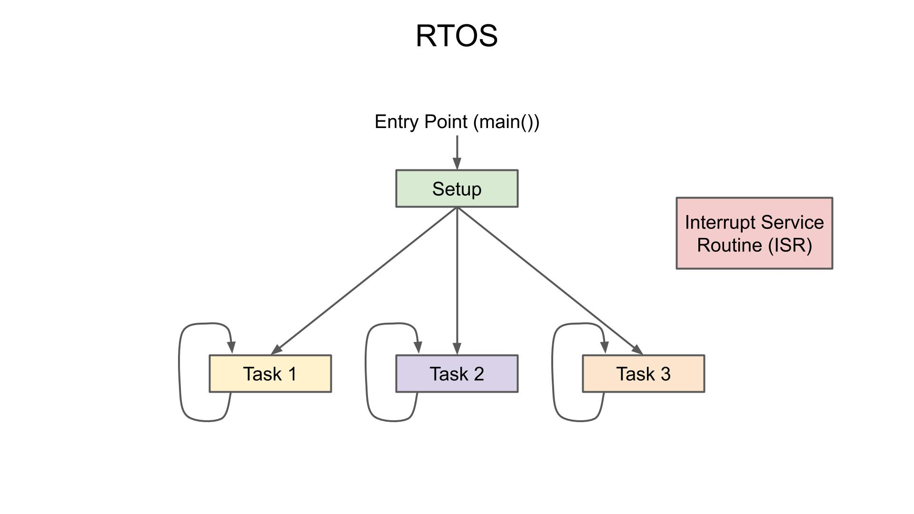
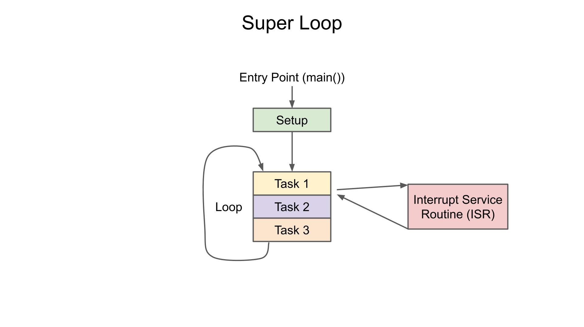
Superloop vs Real-Time OS
https://www.digikey.nl/en/maker/projects/what-is-a-realtime-operating-system-rtos/28d8087f53844decafa5000d89608016

Slide 6
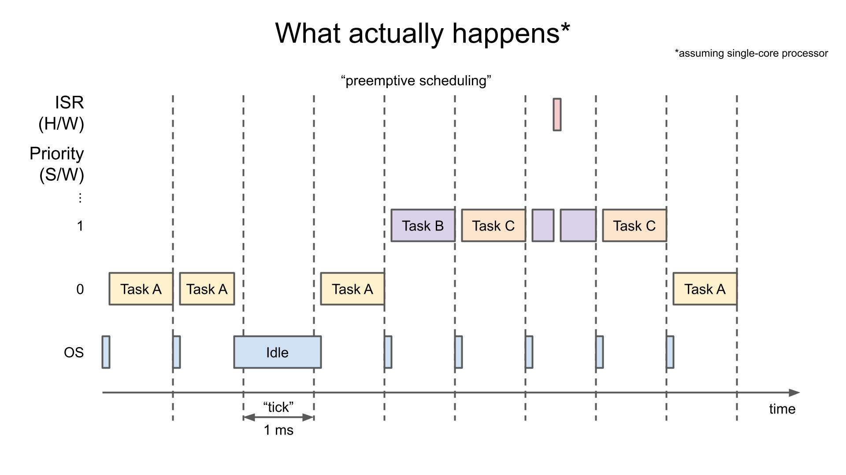
Multitasking
Different tasks are scheduled in time slots by the scheduler. It appears as of they run concurrently.
It is also possible to prioritise the tasks.

Slide 7
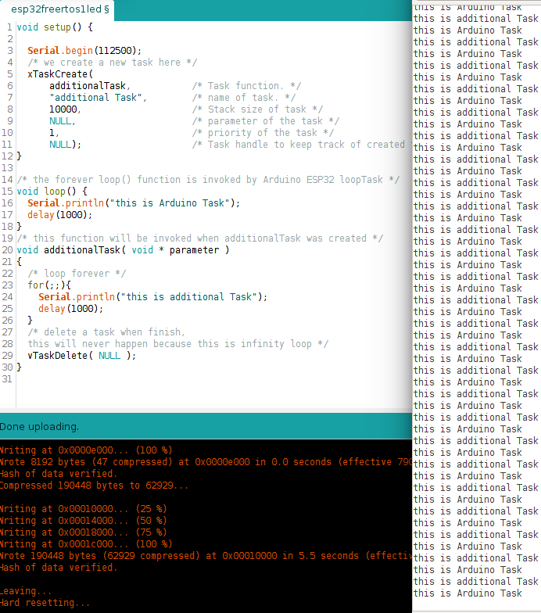
Multitasking Example Code

Slide 8
Task Lifetime
A freeRTOS task can be created by one of the task creation API’s. The most common API is:
xTaskCreate()
Normally, task is being run infinitely, sometimes you want to run only one procedure and then stop the task. Then you should not forget to delete this task and clean up all resources:
void vTaskDelete(NULL)
Please study Semaphore API at https://docs.espressif.com/projects/esp-idf/en/v4.3/esp32/api-reference/system/freertos.html?highlight=mutex#task-api or other sources as well

Slide 9
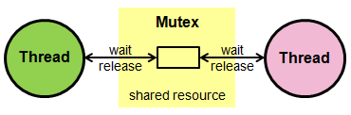
Mutex (Mutual Exclusion)
Mutex avoids more threads to access/override shared data at the same time
Note: most of the OS’es call freeRTOS’s task thread. freeRTOS has different naming

Slide 10
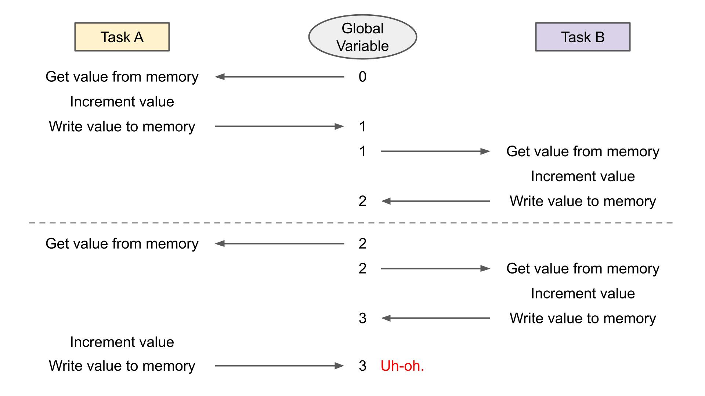
Mutex
Problem
https://www.digikey.nl/en/maker/projects/introduction-to-rtos-solution-to-part-6-freertos-mutex-example/c6e3581aa2204f1380e83a9b4c3807a6

Slide 11
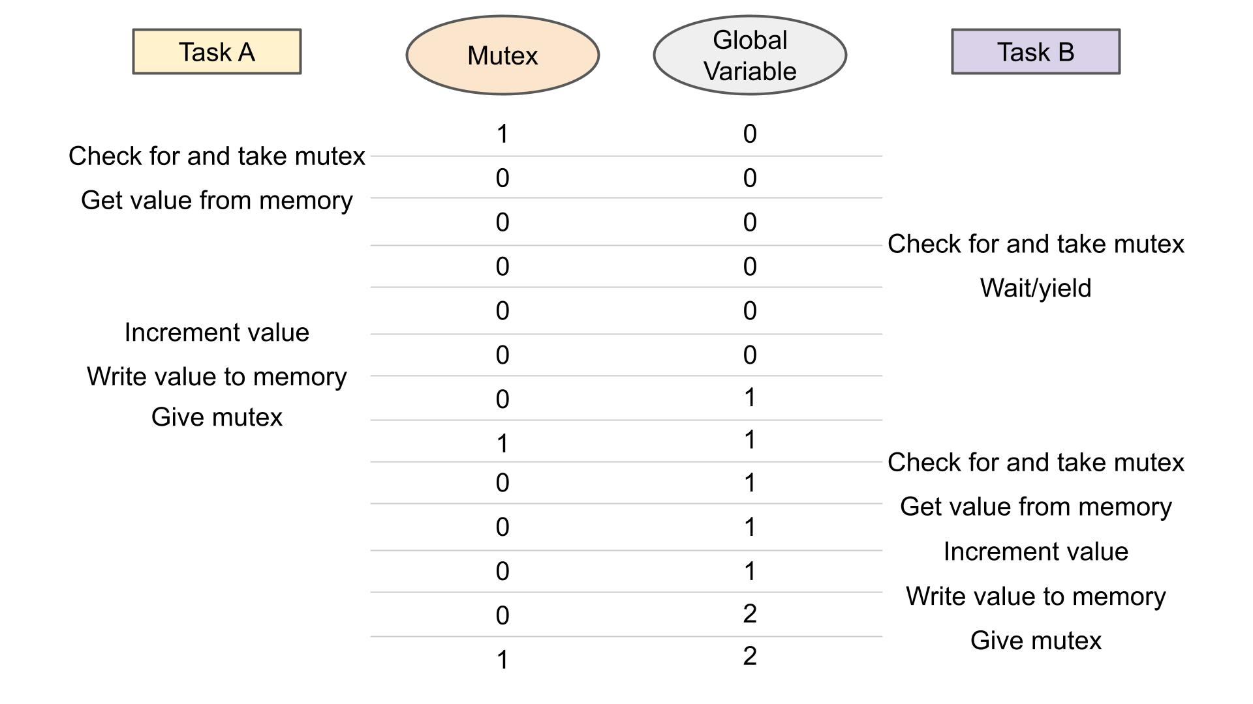
Mutex
Possible Solution:
Mutex
https://www.digikey.nl/en/maker/projects/introduction-to-rtos-solution-to-part-6-freertos-mutex-example/c6e3581aa2204f1380e83a9b4c3807a6

Slide 12
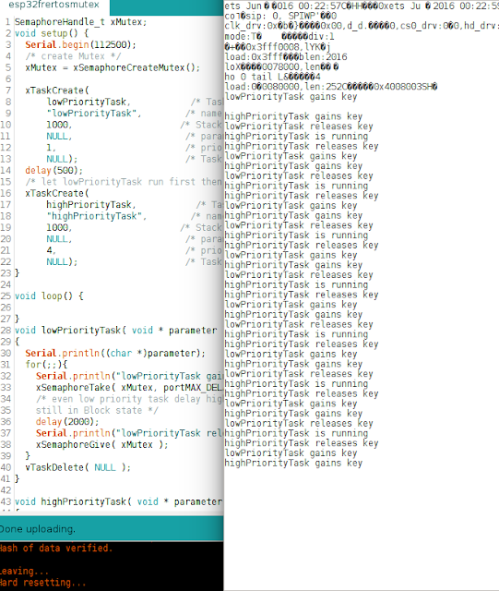
Mutex Code Example

Slide 13
Mutex API
Most used Semaphore/Mutex API’s and macros:
xSemaphoreCreateMutex();
xSemaphoreTake();
xSemaphoreGive();
Please study Semaphore API at https://docs.espressif.com/projects/esp-idf/en/v4.3/esp32/api-reference/system/freertos.html?highlight=mutex#semaphore-api or other sources well.

Slide 14
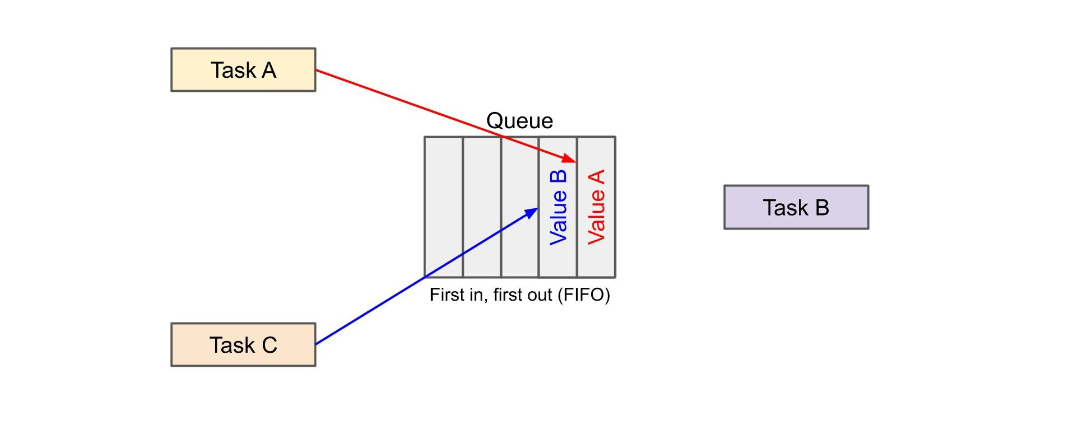
Queues
Queues are used to communicate between tasks. They also buffer data if the speed of the sender is not the same as speed of the receiver.

Slide 15
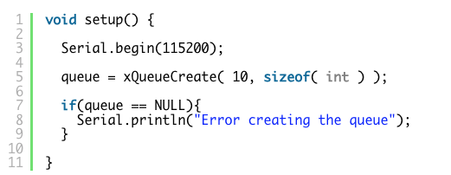
Example Queue Code

Slide 16
Queue API
Most used Queue API’s and macros:
xQueueCreate();
xQueueSend();
xQueueReceive();
Please study Semaphore API at https://docs.espressif.com/projects/esp-idf/en/v4.3/esp32/api-reference/system/freertos.html?highlight=mutex#queue-api or other sources well.

Slide 17

What’s Next
Please study materials at
https://www.freertos.org/FreeRTOS-quick-start-guide.html, sources/videos from Canvas and GIT repository
Be aware that ESP32 version (as well as the one from STM32) are not completely the same as standard freeRTOS version. Often, macros are used to make it as common as possible
For advanced, there is also material on freeRTOS on STM32 which can be found in GIT repository and will be shortly introduced on STM32/Embedded lessons.

